Slide 2
learn install Splunk enterprise on windows.

Slide 3
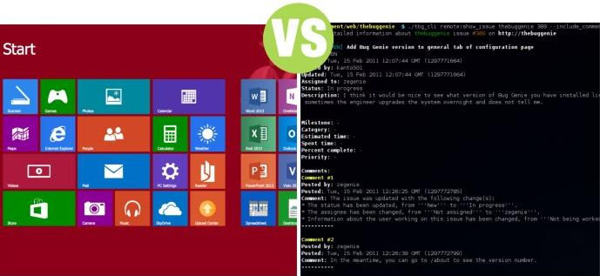

Slide 4
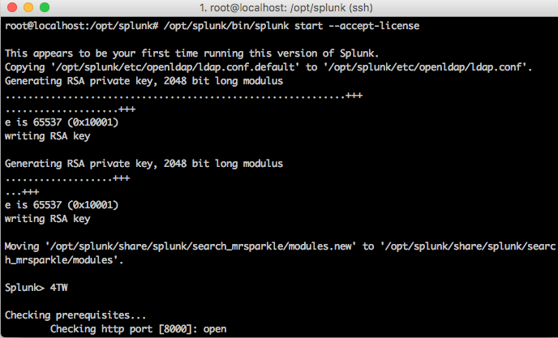
Silent installation

Slide 5

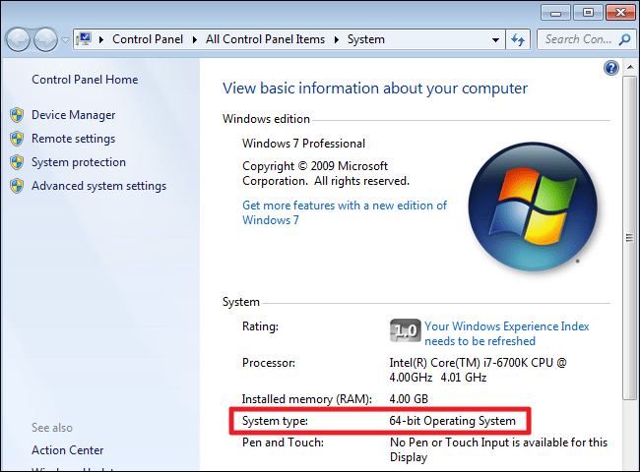
32-bit version of Splunk Enterprise

Slide 6
32-bit version of Splunk Enterprise

Slide 7
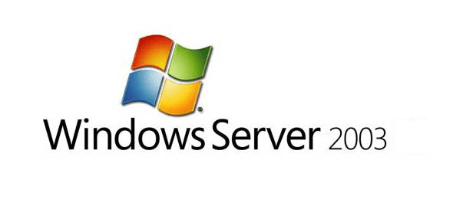

Slide 8
Before you install

Slide 9
Before you install
Choose the Windows user Splunk should run as
Disable or limit antivirus software if able
Consider installing Splunk software into a directory with a short path name

Slide 10
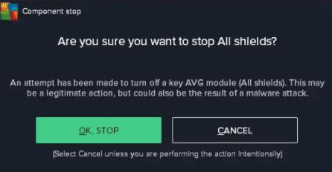
Disable or limit antivirus software if able

Slide 11
Choose the Windows user Splunk should run as
\Program Files\Splunk

Slide 12
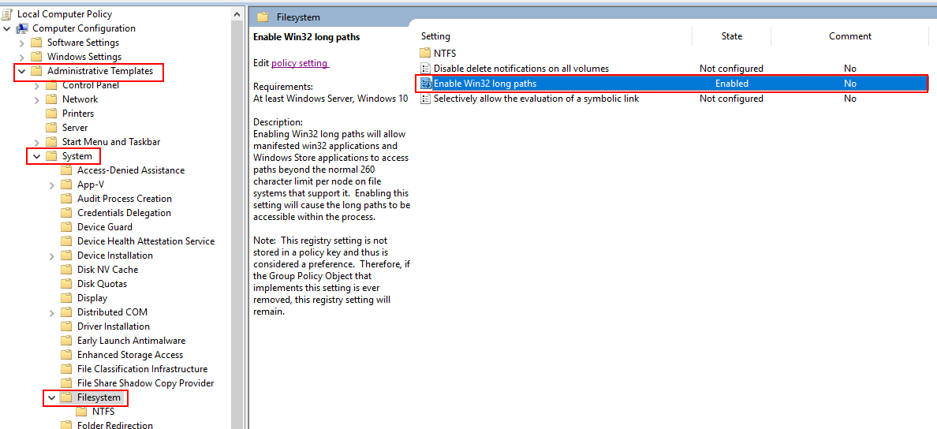
Choose the Windows user Splunk should run as
The Windows API has a path limitation of MAX_PATH which Microsoft defines as 260 characters including the drive letter, colon, backslash,
256-characters for the path, and a null terminating character.

Slide 13
Choose the Windows user Splunk should run as
Installing the software into a directory with a short path length
C:\Splunk or D:\SPL

Slide 14
Install Splunk Enterprise via the GUI installer

Slide 15
Install Splunk Enterprise via the GUI installer
https://www.splunk.com/en_us/download.html

Slide 16

Install Splunk Enterprise via the GUI installer
https://www.splunk.com/en_us/download.html

Slide 17
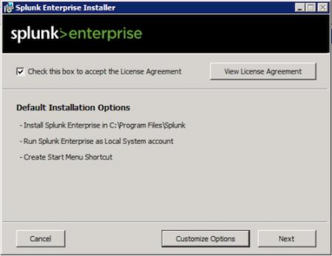
Install Splunk Enterprise via the GUI installer
https://www.splunk.com/en_us/download.html
Double click the splunk.msi file.

Slide 18
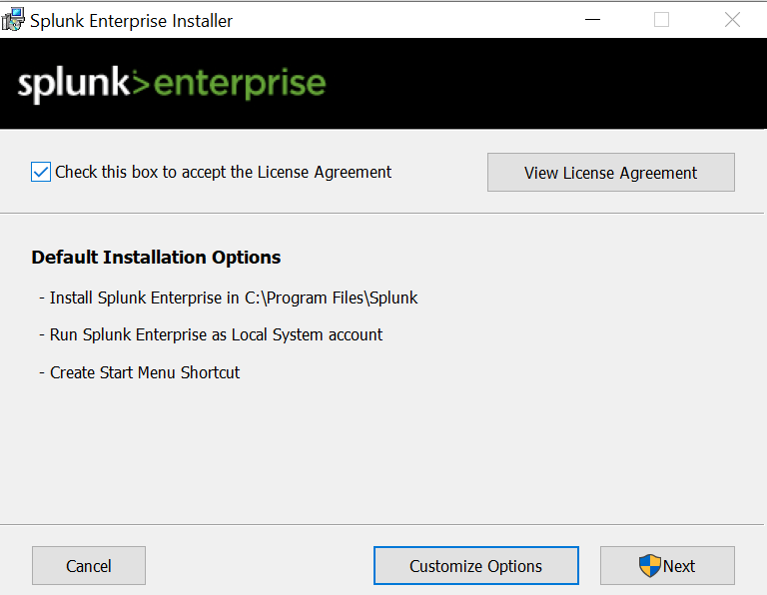
Install Splunk Enterprise via the GUI installer

Slide 19
Install Splunk Enterprise via the GUI installer

Slide 20
Customize options during the installation

Slide 21
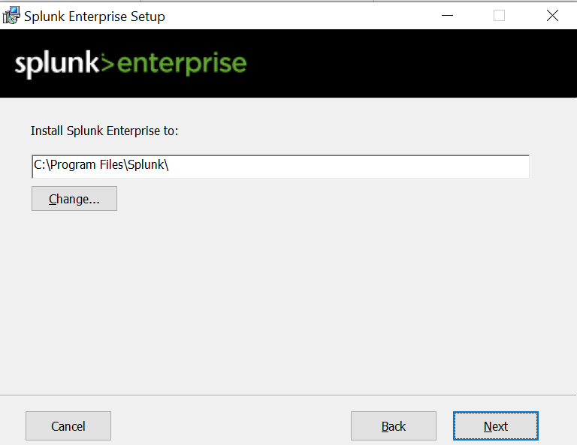
Install Splunk Enterprise via the GUI installer
Install Splunk Enterprise

Slide 22
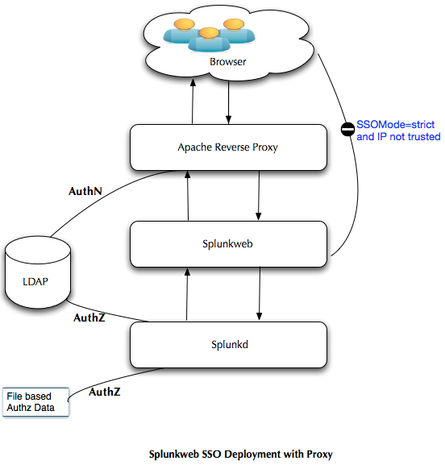
Customize options during the installation

Slide 23
Customize options during the installation
These services install and run as the user you specify on the "Choose the user Splunk Enterprise should run as" panel. You can choose to run Splunk Enterprise as the Local System user, or another user.
domain\username format

Slide 24
Customize options during the installation
These services install and run as the user you specify on the "Choose the user Splunk Enterprise should run as" panel. You can choose to run Splunk Enterprise as the Local System user, or another user.
domain\username format.

Slide 25
Customize options during the installation
Splunk Enterprise must run under
  either the Local System account or a valid user account with a valid password and local administrator privileges.

Slide 26
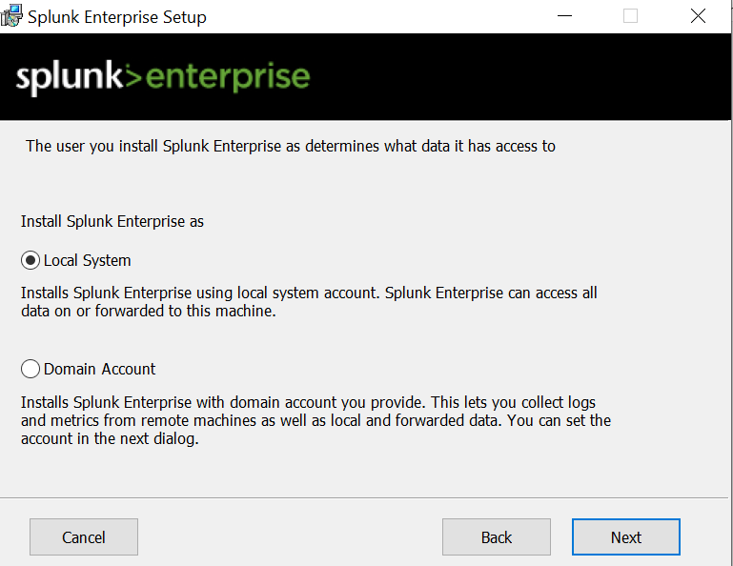
Customize options during the installation

Slide 27
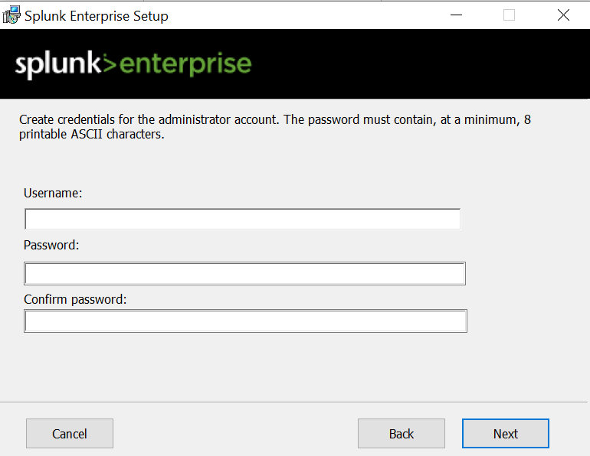
Customize options during the installation

Slide 28
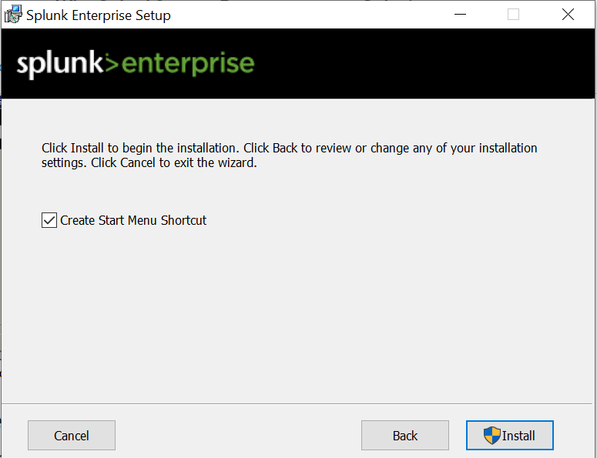
Customize options during the installation

Slide 29
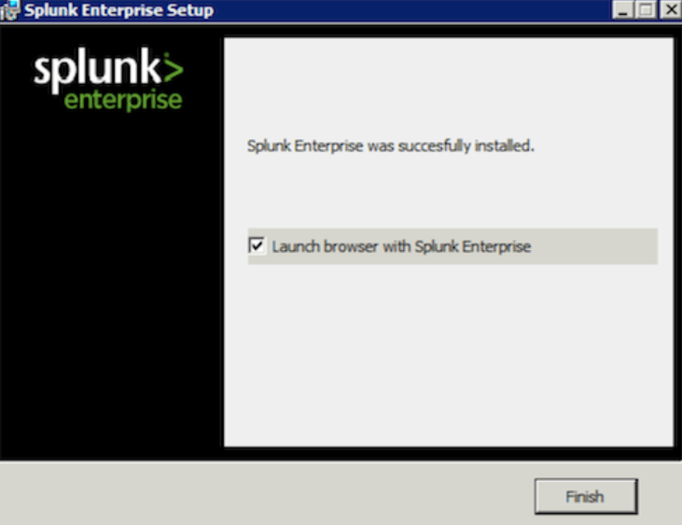
Complete the installation

Slide 30
Install or upgrade license

